Slide 1

MICROPROCESSORS | BIOMEDICAL ENGINEERING
AuraFlowIV
An Automated IV Drip Monitoring and Control System
Hardware: Arduino UNO R3 |Software Simulation: Tinkercad | Language: Vscode C++
GROUP MEMBERS
7298723 — Claresta Gytha Mawusenam Quist
Team Lead
7297523 — Bernard Nana Ofosu
7297723 — Opoku Peggy Amoakwaa
Structural Engineer
Clinical Lead
7292923 — Appiah Kwakye Nana Yaw
7295923 — Kwarteng Samuel Darkwah
Software Architect
Submission Deadline: March 29, 2026
Notes:
1

Slide 2
Presentation Outline
01
Problem Statement
05
Methodology & Code Walkthrough
02
Aim & Objectives
06
Simulation & Demonstration
03
System Overview & Components
07
Conclusion, Challenges & Future Work
04
Circuit Design & Connections
Notes:
2

Slide 3




Problem Statement
Medical Challenge
Clinical Problem
​In most clinical settings in developing regions, IV therapy is managed via a gravity-fed system using a manual roller clamp.
​As the volume of fluid in the IV bag decreases, the pressure changes, causing the drip rate to slow down. Conversely, patient movement can accidentally loosen the clamp.
​
Nurses are required to manually count drops using a stopwatch. In a busy ward with a high patient-to-nurse ratio, this monitoring happens infrequently, leading to "Set and Forget" behavior.
Manual gravity-fed IV sets lack closed loop feedback, leading to risks of fluid overload and undetected occlusions
Healthcare gap
Existing electronic pumps are costly for many healthcare facilities
Medical Need
A reliable, automated safety solution that prevents life-threatening fluid complications through real-time monitoring and active occlusion detection
Notes:
3

Slide 4



Aim and Objectives
To design and prototype AuraflowIV, an automated, low-cost infusion monitoring and control system that maintains a prescribed drip rate and alerts clinical staff to occlusion or flow-rate instability
1
2
3
IR Optical Sensing Module
PD Control System
Alert System
To achieve real-time, non-invasive detection of gravity fed drops using interrupt driven signal processing using an infrared sensor
Create a closed loop mechanism that automatically modulates an SG90 servo to maintain the target infusion rate despite hydrostatic pressure change
Program the system with a 12 second timeout window, ensuring prompt detection and audible notification of occlusion or drip-flow cessation
Notes:
4

Slide 5
System Components
Hardware Components
01
02
03
Input
Processing
Output
IR Sensor Module
Arduino Uno R3
16×2 LCD Display with I2C backpack
10kΩ Potentiometer
Vscode IDE (C++)
Buzzer
Connection Tools
Simulation and CAD Tools
Jumper Wires
Tinkercad Circuits
Breadboard
Fusion 360
Notes:
5

Slide 6
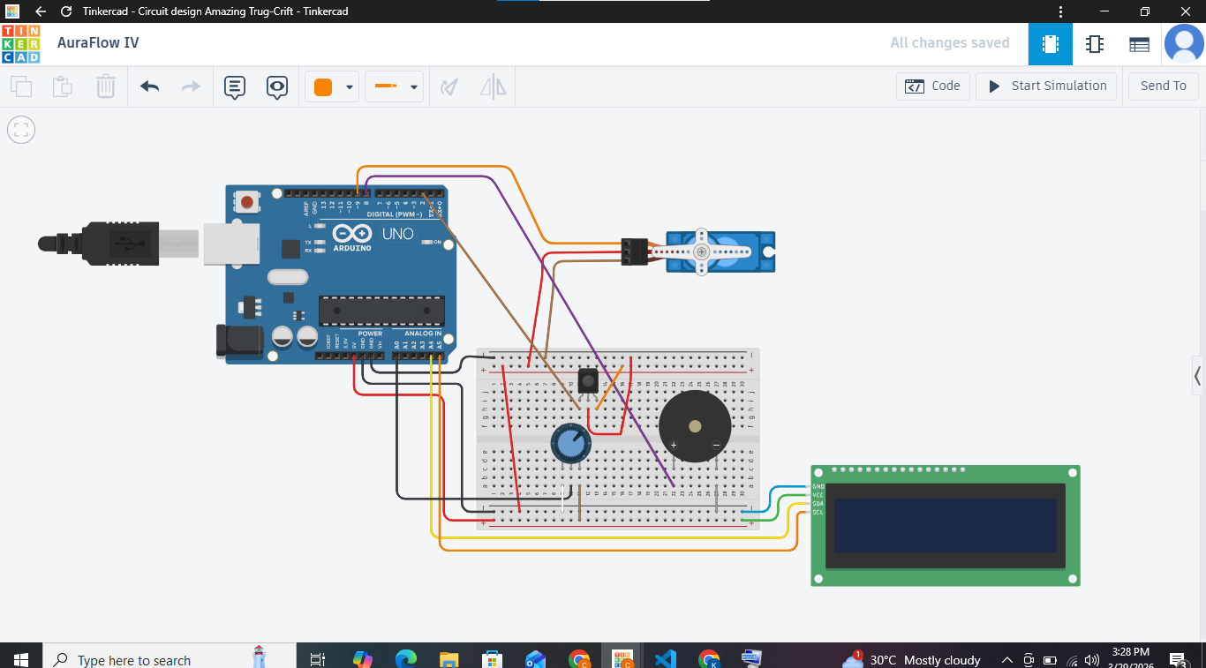
Circuit Connection
Connection Key
Component | Arduino Pin
IR Sensor (Out) | Digital Pin 2
Buzzer + | Digital Pin 8
SG90 microservo | Digital Pin 9
LCD – SDA | Analog Pin A4
LCD – SCLK | Analog Pin A5
Potentiometer | Analog Pin A0
6 / 12
Notes:
6

Slide 7
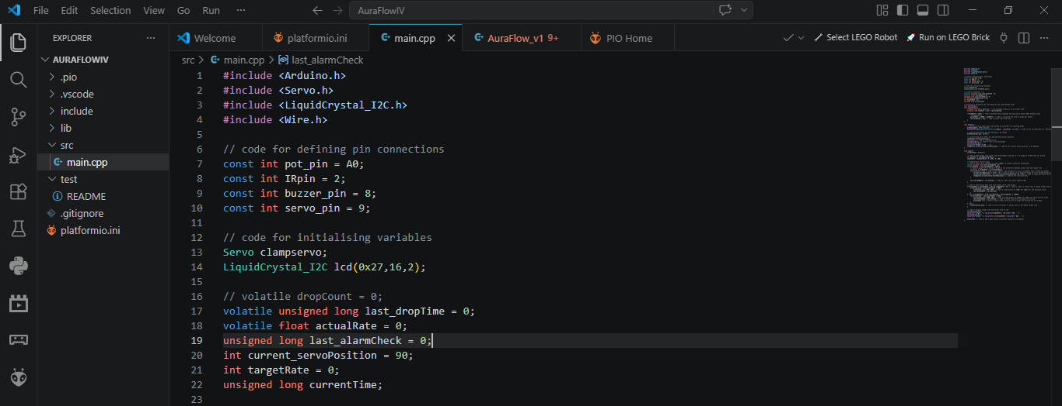
Code Walkthrough
Library Import
LiquidCrystal_I2C.h gives us full control over the 16×2 LCD display with I2C backpack.
Servo.h gives us control of the servo motor
Pin Declarations
Potentiometer on pin A0, IR sensor on pin 2, Buzzer on pin 8, microservo on pin .
Initialising Variables
ldefines and initialises critical functions and variables necessary for feedback control
Setup Function
Initialises the hardware components, sets pin modes and starting positions
8 / 12
Notes:
8

Slide 8
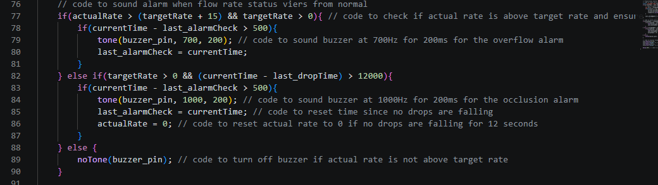
Code Walkthrough
8 / 12
Notes:
8

Slide 9
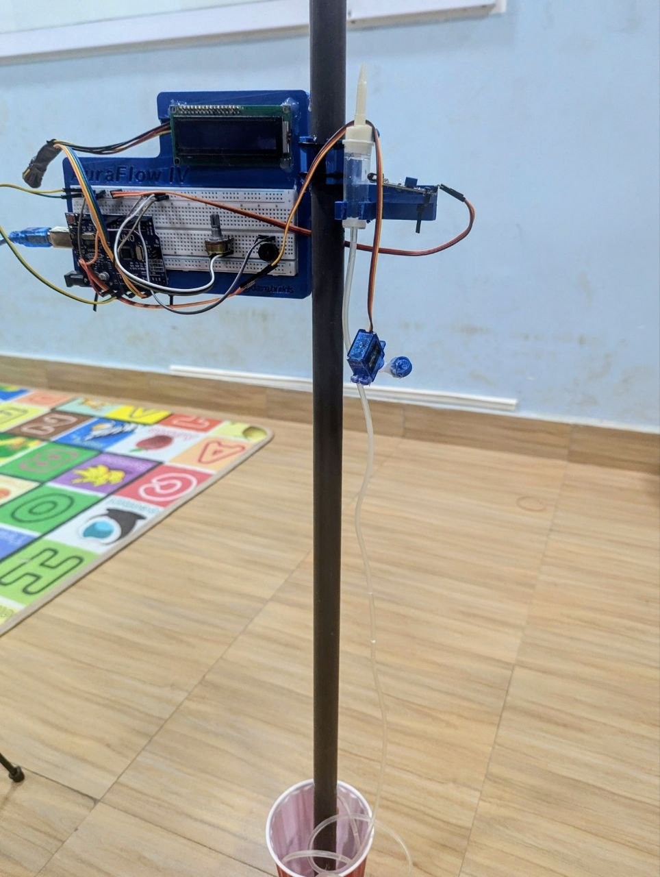
Physical Prototype
Drip stand
Simulates a clinical drip pole of standard size
3d model base
Holds all components in place
8 / 12
Notes:
8

Slide 10

What’s Next?
Integrate a battery module for power outages
PCB connection for reduced prototype size.
Improved prototype panel for variable drip chambers and drip stand
Mobile app for centralized monitoring
Notes:
8

